Slide 1

Walmart Data Analysis Project
Dishant Salunke

Slide 2
Purposes Of The Project
The major aim of this project is to gain insight into the sales data of Walmart to understand the different factors that affect sales of the different branches.

Slide 3
About the Data
About Data The dataset was obtained from the Kaggle Walmart Sales Forecasting Competition.
This dataset contains sales transactions from a three different branches of Walmart, respectively located in Mandalay, Yangon and Naypyitaw.
The data contains 17 columns and 1000 rows

Slide 4
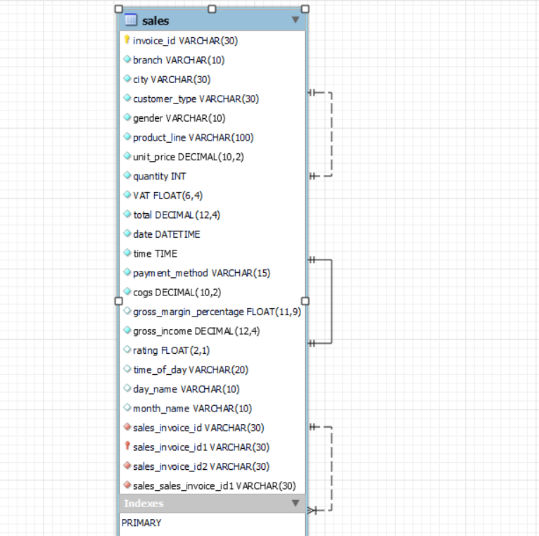

Slide 5
Analysis List
Product Analysis
1.Product Analysis
Conduct analysis on the data to understand the different product lines, the products lines performing best and the product lines that need to be improved.
2.Sales Analysis
This analysis aims to answer the question of the sales trends of product. The result of this can help use measure the effectiveness of each sales strategy the business applies and what modificatoins are needed to gain more sales.
3. Customer Analysis
This analysis aims to uncover the different customers segments, purchase trends and the profitability of each customer segment.

Slide 6
Approach Used
Data Wrangling
Feature Engineering
Exploratory Data Analysis (EDA)

Slide 7
Data Wrangling
This is the first step where inspection of data is done to make sure NULL values and missing values are detected and data replacement methods are used to replace, missing or NULL values.
Build a database
Create table and insert the data.
Select columns with null values in them. There are no null values in our database as in creating the tables, we set NOT NULL for each field, hence null values are filtered out.

Slide 8
Feature Engineering
This will help use generate some new columns from existing ones.
Add a new column named 'time_of_day' to give insight of sales in the Morning, Afternoon and Evening. This will help answer the question on which part of the day most sales are made.
Add a new column named day_name that contains the extracted days of the week on which the given transaction took place (Mon, Tue, Wed, Thur, Fri). This will help answer the question on which week of the day each branch is busiest.
Add a new column named month_name that contains the extracted months of the year on which the given transaction took place (Jan, Feb, Mar). Help determine which month of the year has the most sales and profit.

Slide 9
Conclusion/Findings
There are 3 unique cities in the data Yangon, Naypyitaw, Mandalay There are 6 product category in data amongst Fashion and accessories is the most selling product followed by Food and beverages. January has the most selling month in the year having revenue 116291 $

Slide 10

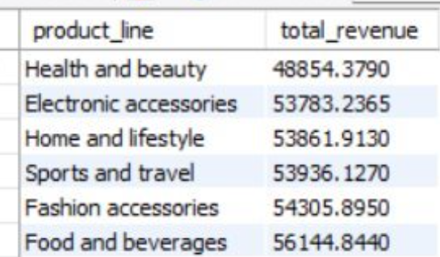
which product line has the largest revenue

